Slide 1
What’s New in .NET Core 3.0
Jason Bock
Practice Lead

Slide 2
Personal Info
http://www.magenic.com
http://www.jasonbock.net
https://www.twitter.com/jasonbock
https://www.github.com/jasonbock
jasonb@magenic.com

Slide 3
Downloads
https://github.com/JasonBock/Quixo
https://github.com/JasonBock/BlazingTheWeb
https://github.com/JasonBock/WhatsNewInNETCore3
https://github.com/JasonBock/Presentations

Slide 4
Overview
Journey
Features
Roadmap
Remember:
https://github.com/JasonBock/Quixo
https://github.com/JasonBock/BlazingTheWeb
https://github.com/JasonBock/WhatsNewInNETCore3
https://github.com/JasonBock/Presentations

Slide 5



Journey
https://upload.wikimedia.org/wikipedia/en/thumb/6/60/Microsoft_logo_%281975%29.svg/1024px-Microsoft_logo_%281975%29.svg.png
http://diylogodesigns.com/blog/wp-content/uploads/2016/04/Microsoft-Logo-icon-png-Transparent-Background.png
https://docs.microsoft.com/en-us/dotnet/images/hub/net.svg
Notes:
The history of .NET started back in the late 90s, and the journey to being an open, cross-platform technology is quite interesting.

Slide 6

Journey
http://www.omshantiinfotech.com/img/Microsoft-window.png
Notes:
In 2002, Microsoft released the first version of .NET. At this time, nothing was open-source, nor was it cross-platform

Slide 7

Journey
http://cdn5.windowswally.com/wp-content/uploads/2014/09/NET-Framework-3.5-in-Windows-8-Featured-Windows-Wally-300x300.png
Notes:
In the beginning….was the .NET Framework. It was the “one runtime to rule all languages”, or something like that. It only worked on Windows.

Slide 8

Journey
https://luauf.com/wp-content/uploads/2008/05/mono-logo.png
Notes:
There was also Mono, which was an open source implementation. The vast majority of .NET developers didn’t target this, but it was another option, and it let devs target other OSes.

Slide 9


Journey
https://www.wired.com/wp-content/uploads/2010/09/Microsoft_Silverlight.jpg
Notes:
At some point, Silverlight came into being, letting .NET devs target the browser but staying completely within .NET. And the world started to get complicated.

Slide 10


Journey
https://www.xamarin.com/content/images/pages/branding/assets/xamagon.png
Notes:
Then, Xamarin came forth, letting .NET devs target mobile platforms, and the icons got smaller.

Slide 11



Journey
https://www.xamarin.com/content/images/pages/branding/assets/xamagon.png
Notes:
Then, Xamarin came forth, letting .NET devs target mobile platforms, and the icons got smaller.

Slide 12

Journey
https://raw.githubusercontent.com/NuGet/Home/dev/resources/nuget.png
https://github.com/dotnet/core/blob/master/release-notes/2.1/2.1-supported-os.md
Notes:
And finally, with everything going open-source, cross-platform has become a reality with .NET Core. Windows, Mac and Linux. It was originally “Project K”, a new version of ASP.NET, and it rapidly moved into .NET Core.

Slide 13
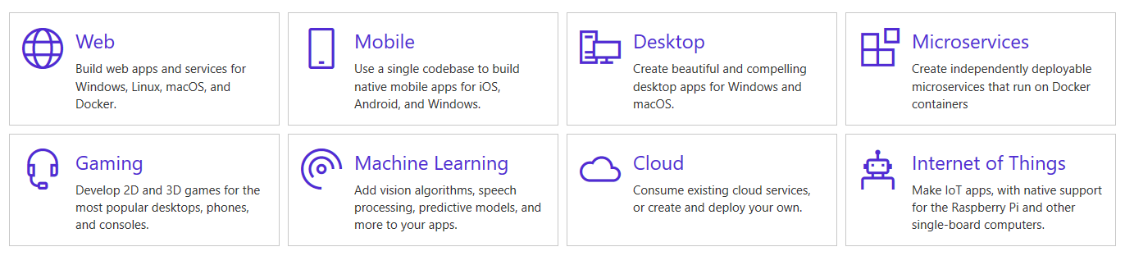
Journey
https://dotnet.microsoft.com/
Notes:
.NET Core, and .NET in general, can be used in so many areas

Slide 14
Journey
Cross-platform
Consistent across architectures
Command-line tools
Flexible deployment
Compatible
Open source
Supported by Microsoft
https://docs.microsoft.com/en-us/dotnet/core/about
Notes:
Here are some key .NET Core features. Let’s cover two key areas in my mind

Slide 15
Journey
The degree of improvement is absolutely astonishing, going from 2,120 requests per second on Mono in Round 11 to 1,822,366 requests per second on ASP.NET Core in Round 13. That’s an approximately 85,900% improvement, and that doesn’t even account for Round 11’s hardware being faster than our new hardware. That is not a typo, it's 859 times faster!
https://www.techempower.com/blog/2016/11/16/framework-benchmarks-round-13/
Notes:
Speed. .NET Core is FAST.

Slide 16
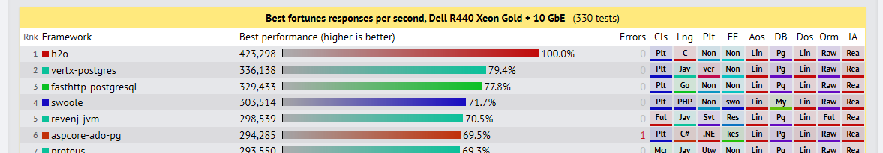
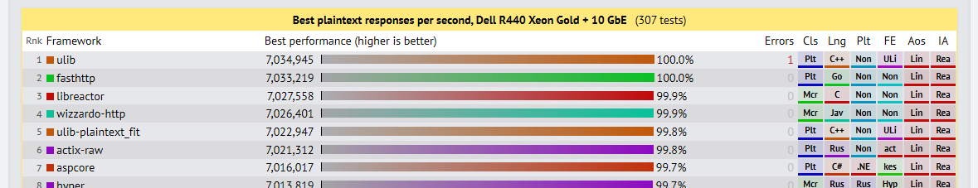
Journey
https://www.techempower.com/blog/2018/10/30/framework-benchmarks-round-17/
Notes:
Speed. .NET Core is FAST.

Slide 17
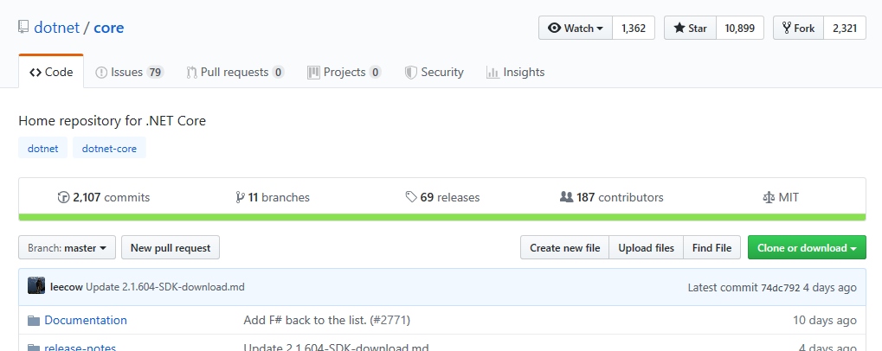
Journey
https://github.com/dotnet/core
Notes:
Open source. Many people, both Microsoft employees and outside their walls, have contributed to .NET to make it better in so many ways.

Slide 18
Features
Windows Desktop Support (WinForms and WPF)
Self-Contained EXEs
Artificial Intelligence and Machine Learning
ASP.NET Core Improvements
Client-Side Web Development
Performance Improvements
C#8
APIs
Notes:
Here’s a general list of things that are in .NET Core 3.0. Let’s take a deeper dive.

Slide 19

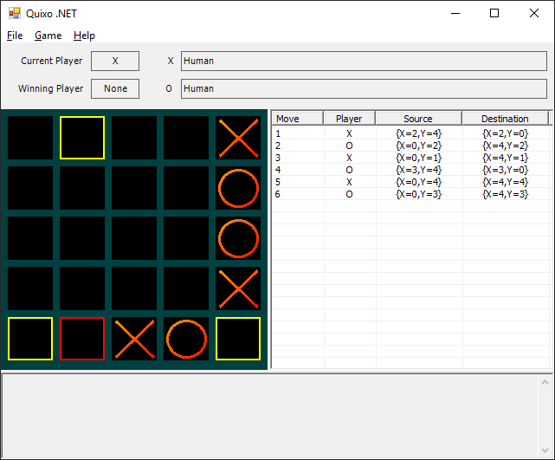
Features
.NET 4.7.1
.NET 4.6.1
.NET 4.0
.NET 4.6.2
https://image.flaticon.com/icons/png/512/82/82365.png
Notes:
Versioning has always been a problem with .NET Framework.

Slide 20
Features
.NET Core 3.0
.NET Core 3.0 ++
Nothing!
.NET Core 3.0
https://image.flaticon.com/icons/png/512/82/82365.png
Notes:
With .NET Core 3.0, you can target WinForms, WPF, and WinUI apps. This makes it easier to publish/deploy apps. You can make self-contained targets as well, so it doesn’t matter if the runtime exists.

Slide 21
Demo: Moving Quixo to .NET Core
What’s New in .NET Core 3.0

Slide 22

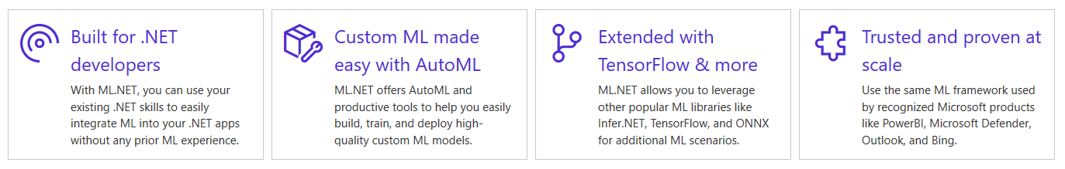
Features
https://dotnet.microsoft.com/apps/machinelearning-ai/ml-dotnet
Notes:
AI & ML are hot topics for developers these days. ML.NET is a framework for .NET developers to work with models and libraries to add these capabilities into their applications.

Slide 23
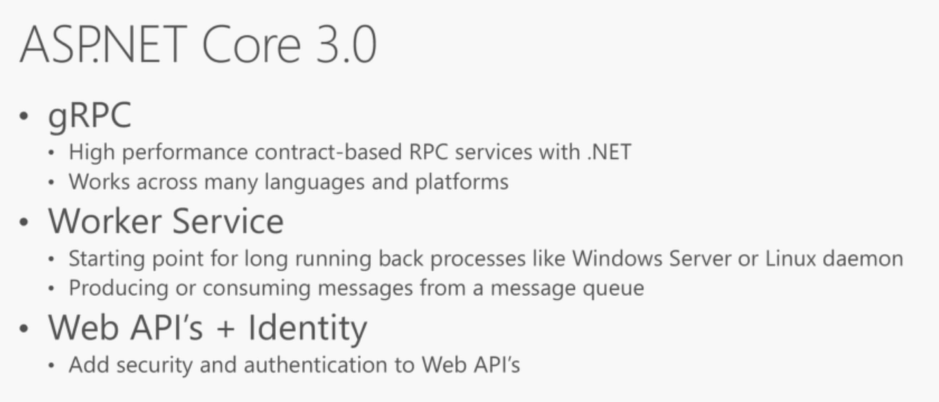
Features
https://youtu.be/cteCGBRUB_4?t=424
Notes:
ASP.NET 3.0 is getting better. This is just a general overview of some of these changes.

Slide 24


Features
https://dotnet.microsoft.com/apps/aspnet/web-apps/client
Notes:
One of the most exciting features is Blazor. You can now run C# code in the browser. This isn’t Silverlight; this runs on top of WebAssembly.

Slide 25
Demo: Calculations, Geolocation, Graphs, and Blazor
What’s New in .NET Core 3.0

Slide 26
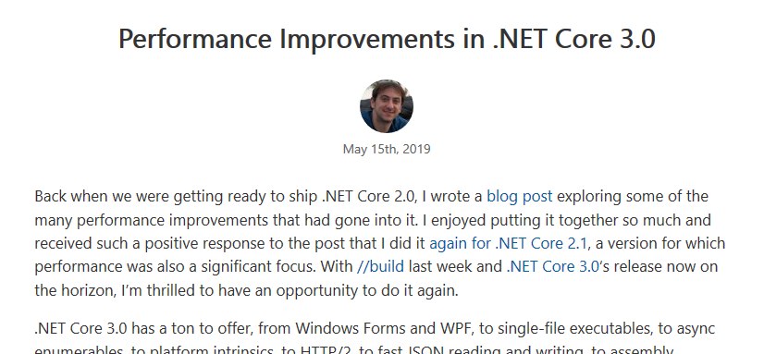
Features
https://devblogs.microsoft.com/dotnet/performance-improvements-in-net-core-3-0/
Notes:
The reason .NET Core is so good in the TechEmpower benchmarks is that there is a culture of performance around the runtime.

Slide 27
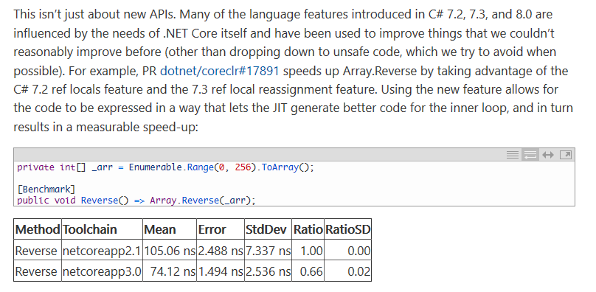
Features
https://devblogs.microsoft.com/dotnet/performance-improvements-in-net-core-3-0/
Notes:
The article is quite dense, but the deep work being done by the community is impressive. They make seem like small wins, but operations like this can have tremendous impacts depending on what code does.

Slide 28
Features
C#8
Default Interface Methods
Nullable reference type
Recursive patterns
Async streams
Enhanced using
Ranges
Null-coalescing Assignment
Alternative interpolated verbatim strings
stackalloc in nested contexts
Unmanaged generic structs
Static local functions
Readonly members
https://github.com/dotnet/roslyn/blob/master/docs/Language%20Feature%20Status.md
Notes:
C#8 is coming with .NET Core 3.0. The language major release cycle is no longer tied to VS/.NET Framework.

Slide 29
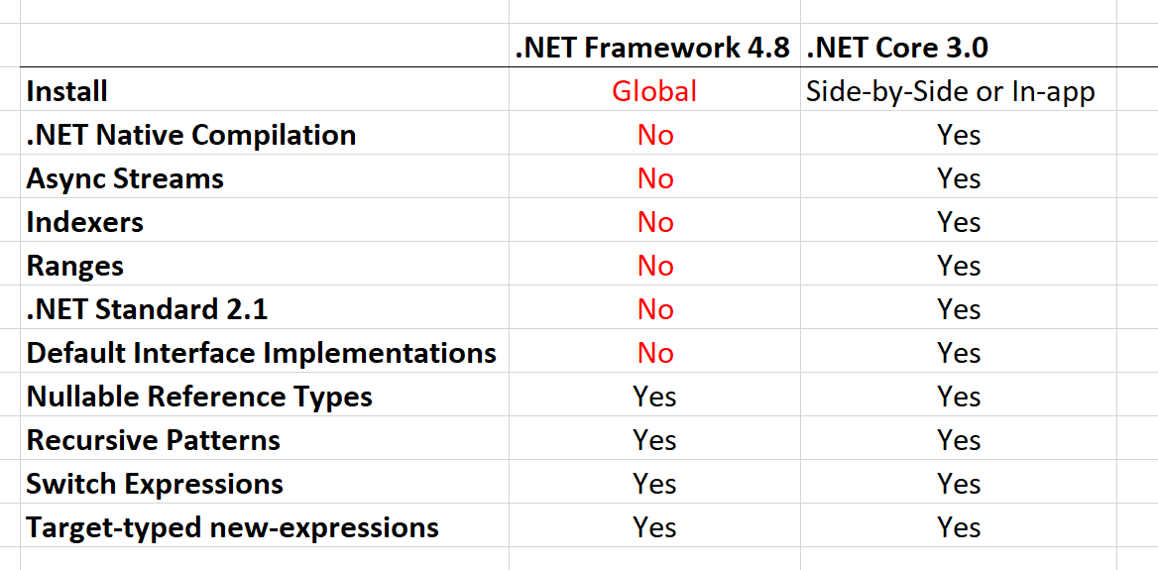
Features
https://twitter.com/dotMorten/status/1105343335164596224?s=09
Notes:
Note that C#8 won’t fully work in .NET Framework 4.8

Slide 30
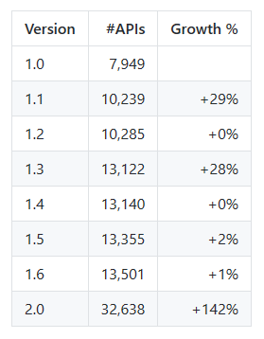
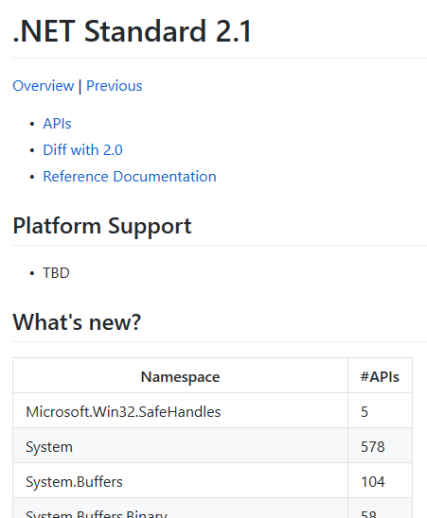
Features
https://github.com/dotnet/standard/blob/master/docs/faq.md
https://github.com/dotnet/standard/blob/master/docs/versions/netstandard2.1.md
Notes:
.NET Core 3.0 will support .NET Standard 2.1. There’s been some API additions, which will make bringing more .NET code over to .NET Core easier. .NET Core also has some of its own additions as well.

Slide 31
Demo: API Additions
What’s New in .NET Core 3.0
Notes:
Show HashCode, IAsyncDisposable, and other new members.
https://github.com/dotnet/standard/blob/master/docs/versions/netstandard2.1.md
https://github.com/dotnet/core/tree/master/release-notes/3.0/preview/api-diff

Slide 32
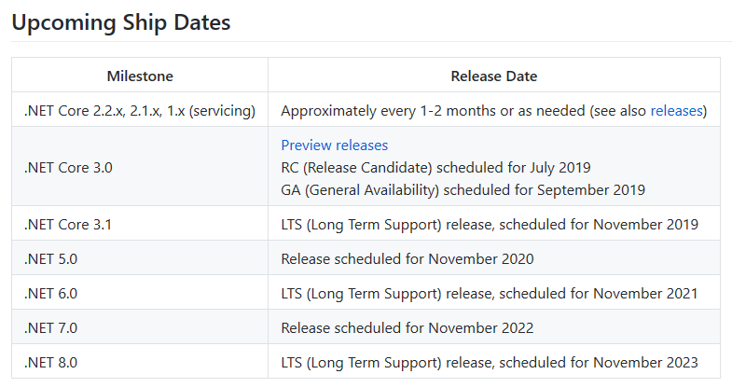
Roadmap
https://github.com/dotnet/core/blob/master/roadmap.md#upcoming-ship-dates
Notes:
So when is .NET Core 3.0 going to go GA? Right now, the date is Sept. 2019. But notice something here….what is .NET 5.0? And beyond?

Slide 33
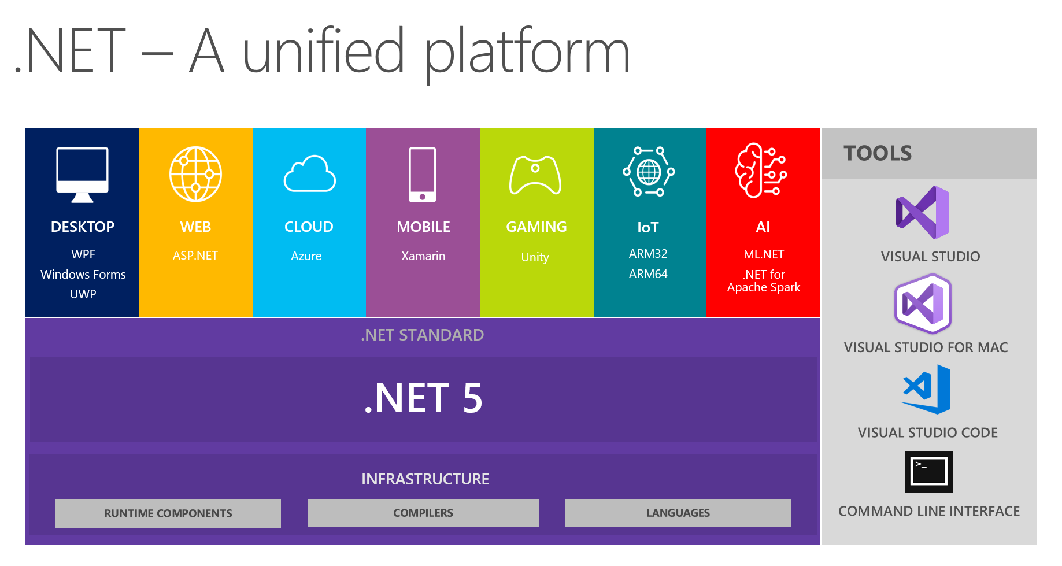
Roadmap
https://devblogs.microsoft.com/dotnet/introducing-net-5/
Notes:
.NET Core is essentially .NET from this point on.

Slide 34
Roadmap
With the .NET Core 3.0 release in September 2019 we think that all *new* .NET applications should be based on .NET Core. The primary application types from .NET Framework are supported, and where we did not port something over there is a recommended modern replacement. All future investment in .NET will be in .NET Core. This includes: Runtime, JIT, AOT, GC, BCL (Base Class Library), C#, VB.NET, F#, ASP.NET, Entity Framework, ML.NET, WinForms, WPF and Xamarin.
.NET Framework 4.8 will be the last major version of .NET Framework. If you have existing .NET Framework applications that you are maintaining, there is no need to move these applications to .NET Core. We will continue to both service and support .NET Framework, which includes bug–, reliability– and security fixes. It will continue to ship with Windows (much of Windows depends on .NET Framework) and we will continue to improve the tooling support for .NET in Visual Studio (Visual Studio is written on .NET Framework).
https://devblogs.microsoft.com/dotnet/net-core-is-the-future-of-net/
Notes:
It’s clear that .NET Framework is “done”. It won’t go away, lots of apps use it, but the path forward is .NET Core.

Slide 35
What’s New in .NET Core 3.0
Remember…
https://github.com/JasonBock/Quixo
https://github.com/JasonBock/BlazingTheWeb
https://github.com/JasonBock/WhatsNewInNETCore3
https://github.com/JasonBock/Presentations
References in the notes on this slide
Jason Bock
Practice Lead
Notes:
Sources:
Official Start Page - https://dotnet.github.io/
CoreFX - https://github.com/dotnet/corefx
Source Index - https://source.dot.net/
.NET API Browser - https://docs.microsoft.com/en-us/dotnet/api/index
References:
First Steps in porting Markdown Monster WPF App to .NET Core 3.0 - https://weblog.west-wind.com/posts/2019/Apr/24/First-Steps-in-porting-Markdown-Monster-to-NET-Core-30
What’s Coming with .NET Core 3.0 - https://channel9.msdn.com/Events/Visual-Studio/Visual-Studio-2019-Launch-Event/Whats-Coming-with-NET-Core-30
MetaDiff - https://github.com/WalkingCat/MetaDiff
Dynamically compile and run code using .NET Core 3.0 - https://laurentkempe.com/2019/02/18/dynamically-compile-and-run-code-using-dotNET-Core-3.0/
Features To Build Better Applications With .NET Core 3 - https://hackernoon.com/features-to-build-better-applications-with-net-core-3-dc320740e0a9
Exploring .NET Core 3.0 new API - https://blog.ndepend.com/exploring-net-core-3-0-new-api/
SimdDoors: Example project demonstrating SIMD intrinsics in .NET Core 3.0 - https://github.com/tgjones/SimdDoors
Announcing .NET Core 3 Preview 2 - https://blogs.msdn.microsoft.com/dotnet/2019/01/29/announcing-net-core-3-preview-2/
What's Coming in .NET Core 3.0 - https://msdn.microsoft.com/en-us/magazine/mt848631.aspx
What's new in .NET Core 3.0 (Preview 1) - https://docs.microsoft.com/en-us/dotnet/core/whats-new/dotnet-core-3-0

